Slide 1
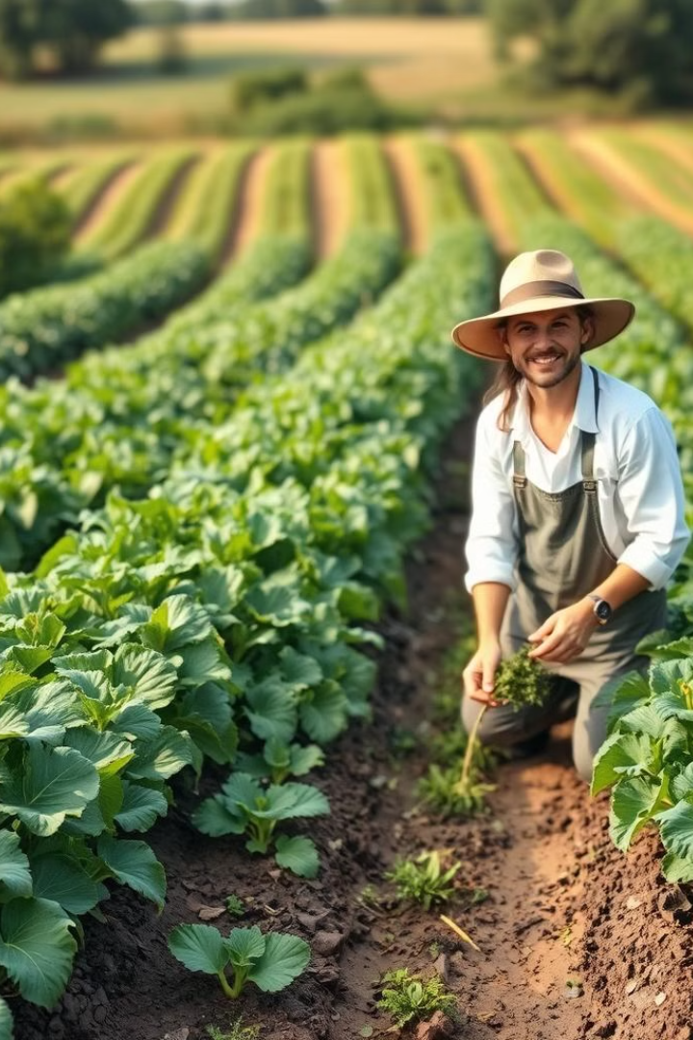
JaivikSetu: Connecting Farmers and Consumers
JaivikSetu aims to bridge the gap between natural farmers and health-conscious consumers by creating a transparent digital marketplace. Our platform ensures fair prices for farmers and authentic organic products for buyers, fostering trust and sustainability.

Slide 2

The Problem: Lack of Trust and Fair Markets
Farmers' Struggle
Consumers' Dilemma
Small-scale farmers who commit to natural farming often lack direct access to consumers, forcing them to sell through intermediaries. These middlemen frequently offer prices that barely cover the cost of production, trapping farmers in a cycle of debt and discouraging sustainable practices.
Consumers are increasingly skeptical about "organic" labels due to widespread reports of fraudulent products in the market. The absence of a reliable verification system makes it difficult for buyers to distinguish genuine organic produce from conventionally grown items falsely marketed as organic, eroding consumer trust.

Slide 3

Our Solution: A Transparent Digital Marketplace
Direct Connection
QR Code Traceability
Fair Pricing
Connect verified natural farmers directly with conscious consumers, eliminating unnecessary middlemen.
Offer QR code-based traceability of origin and farming methods for products, ensuring consumer trust.
Provide fair prices to farmers and affordable organic food to consumers through a transparent system.

Slide 4
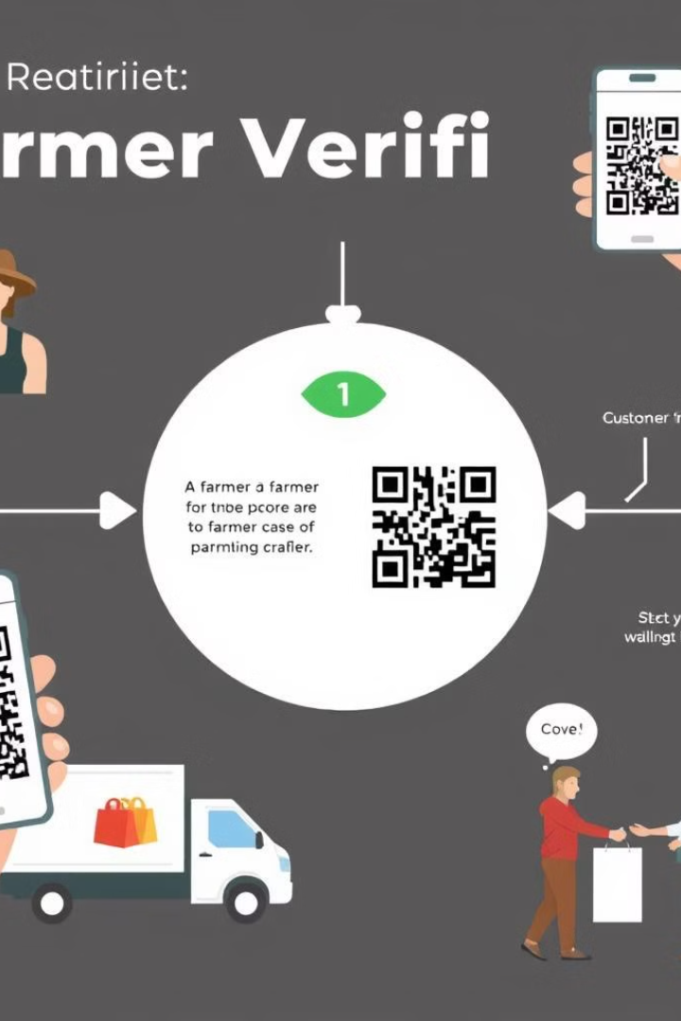




How JaivikSetu Works: A Step-by-Step Approach
Farmer Verification
Farmers submit documents and farming practices for third-party inspection and certification.
QR Code Generation
Each product is assigned a unique QR code linking to details about its origin, farming, and certification.
Direct Selling
Verified farmers list products with fair pricing, allowing consumers to purchase directly.
Order Management
The platform supports easy ordering, secure payments, and doorstep delivery.

Slide 5
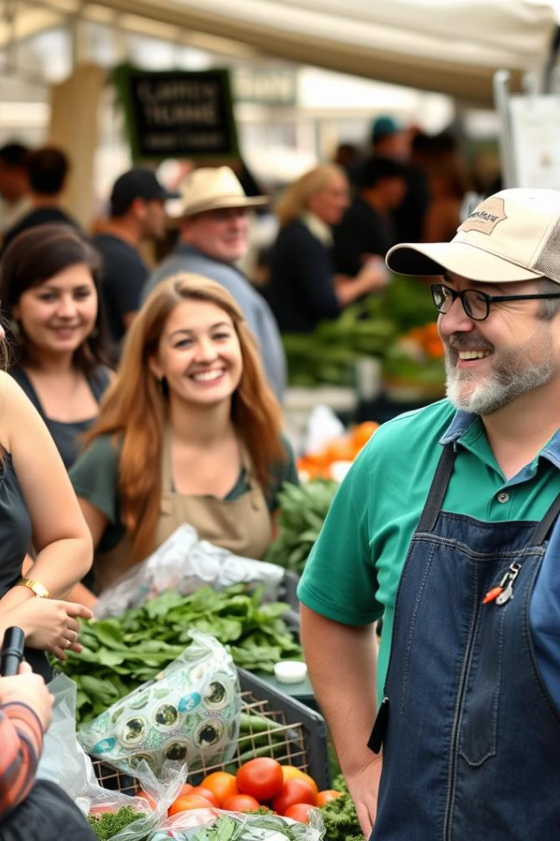



Target Audience: Who Benefits from JaivikSetu?
Farmers
Consumers
Retailers & Restaurants
Small and mid-sized natural farmers who need a better market without middlemen.
Health-conscious buyers who want trustworthy organic products.
Businesses that need certified organic produce.

Slide 6
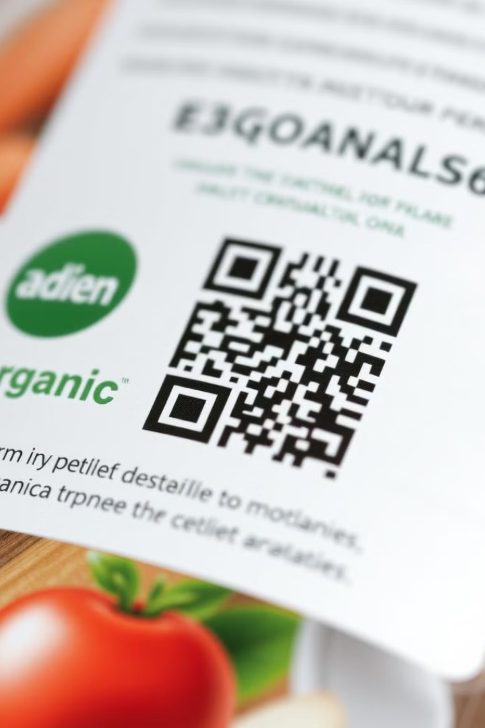
Uniqueness: What Sets Us Apart?
1
Elimination of Middlemen
2
Real-Time Traceability
We offer real-time traceability through QR codes, providing transparency and trust.
Our platform cuts out the middleman, ensuring fair prices for farmers and affordable products for consumers.
3
Certification Process
We ensure a rigorous certification process, allowing only genuine organic farmers to participate.

Slide 7
Frameworks/Technologies: Powering JaivikSetu
Frontend: React
Backend: Django
JaivikSetu's frontend leverages React to deliver a dynamic and responsive user interface. React's component-based architecture allows us to create reusable UI elements, ensuring consistency and maintainability across the platform. Key features include:
The backend is built on Django and Django REST Framework, providing a secure and scalable foundation for JaivikSetu. Django's robust features ensure data integrity and protect against common web vulnerabilities. Key features include:
Secure Data Storage: Django's ORM simplifies database interactions and ensures secure storage of sensitive information.
Product Browsing: React enables smooth and intuitive browsing of organic products with real-time filtering and search.
API Endpoints: Django REST Framework facilitates building APIs for seamless communication between the frontend and backend.
User Account Management: Farmers and consumers can easily manage their profiles, listings, and orders.
Interactive Maps: Integration with mapping libraries allows users to visualize the origin of products and connect with local farmers.
User Authentication: Secure user authentication and authorization mechanisms protect user accounts and data.

Slide 8
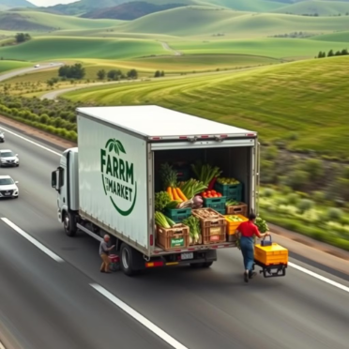
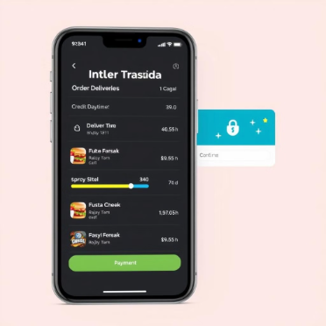
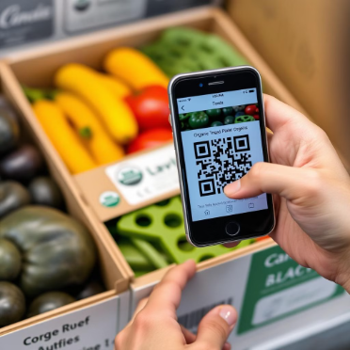
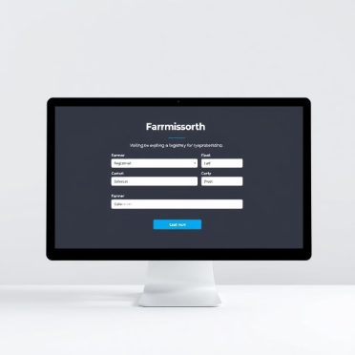
Implementation Ease and Effectiveness
Logistics & Scalability
Consumer Features
Form logistics partnerships and optimize scalability to include more farmers and explore new markets.
QR Code System
Include consumer-focused features like QR scanning, secure payment gateways, and order tracking.
Core Platform
Integrate a QR code system for product traceability, allowing consumers to track the source of their purchase.
Build the core platform for farmer registration, produce listing, and verification.

Slide 9



Addressing Key Issues in the Organic Market
Consumer Trust
1
By ensuring only certified organic farmers can participate, and providing traceability through QR codes, JaivikSetu builds consumer trust.
Fair Pricing
2
Directly connecting farmers and consumers eliminates middlemen, guaranteeing fair prices for organic produce.
Transparency
3
The QR code system allows consumers to track the journey of their products from farm to table, ensuring complete transparency.
JaivikSetu tackles critical issues in the organic market by implementing a rigorous certification process, ensuring fair prices by removing intermediaries, and offering a QR code system for end-to-end traceability. This comprehensive approach not only builds consumer confidence but also encourages farmers to embrace sustainable practices.

Slide 10
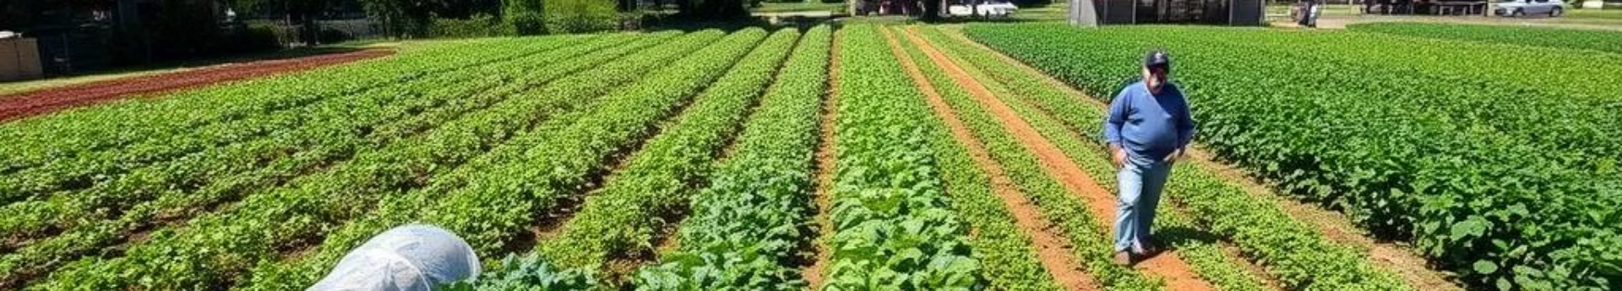
Conclusion: Building a Trusted Organic Marketplace
JaivikSetu aims to develop a trusted marketplace that is farmer-friendly and trusted by consumers. By proactively addressing problems of trust, traceability, and fair pricing, we are creating a sustainable ecosystem for organic products.
Our vision extends beyond a mere transactional platform. We envision a community where farmers are empowered with the tools and resources to thrive, and consumers can confidently access authentic organic produce. By fostering direct connections and transparent practices, JaivikSetu seeks to redefine the organic market landscape.
Through continuous innovation and a steadfast commitment to our core values, we strive to build a resilient and equitable organic marketplace that benefits all stakeholders. JaivikSetu is more than a platform; it's a promise of quality, integrity, and a healthier future for everyone.

